Slide 1
Week 8
Beyond SQL

Slide 2
Pros and Cons of SQL
Pros
Cons
Very popular for a long time so there is a decent amount of documentation and some standards
Relatively simple for people who aren't programmers to learn
There are some built in security and data integrity features
It's possible to see data in different views so you can have more abstraction and can limit user access/viewing when needed
Limits on what it can be used for since it requires structured data
There can be hidden rules which make it harder to control fully
No real time analytics, so things that want real time data processing is an issue
Large datasets can lead to longer processing times because of the way queries perform
Setup of SQL databases can be complicated and need specific skill sets

Slide 3
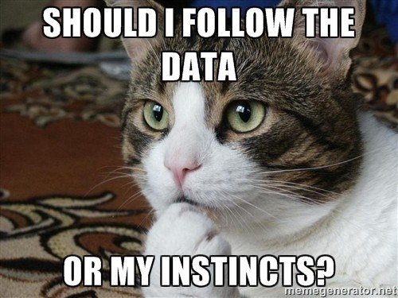
Beyond SQL
NoSQL is non-relational database model, literally non-SQL or not only SQL
NoSQL is useful for larger datasets and real time analytics and data processing especially
There are a lot of different ways you can organize NoSQL type databases, one is by data model
For reference, SQL stores data in tables, NoSQL can store data in many other models including objects, documents and graphs
Because the data is not done in a way that shows relationships, schema are designed differently
NoSQL tends to not use joins in the queries because the data isn't stored in tables, NoSQL uses multiple queries instead

Slide 4
Pros and Cons of NoSQL
Pros
Cons
Scalability for larger datasets
Can store data outside the traditional SQL options
Real time analytics is possible
Less maintenance needed in general
Hasn't been popular as long so there has been less stress testing then SQL
Less complex queries are done so usually multiple queries are used instead of table joins
Additional infrastructure may be needed for scaling
Difficult to change data once added

Slide 5

SQL vs NoSQL
SQL
NoSQL
Relational
Schema is predesigned
Vertically scalable – more power added to scale database, such as upgrading current servers
Based on tables
Needs structured data
Non-relational
Schema can be dynamic to accommodate unstructured data
Horizontally scalable – more nodes are added to scale database, such as adding more servers
Uses other data structures besides tables
Can work with unstructured and semi-structured data

Slide 6
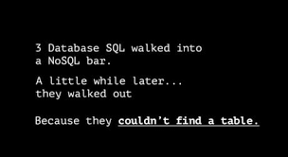
Types of NoSQL
There are multiple ways to classify NoSQL databases, some of which can overlap
One common way to classify the types is by data structure, or the way in which the data is stored
Some common types are graph, key-value and document
The vocab that is used for the way the data is stored can be different than expected, especially if you're coming from programming

Slide 7
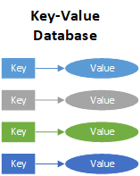
NoSQL Example: Key Value Store
This uses a data structure that is an associative array or dictionary if you're coming from programming
This type will use key-value pairs, each piece of data has an associated key
The unique key is how you can retrieve your data from the database, the data can be simple (string) or complex (object)
One way to think of this is like a relational database but it only has two columns in the table, the key and the value
https://bi-insider.com/posts/key-value-nosql-databases/

Slide 8
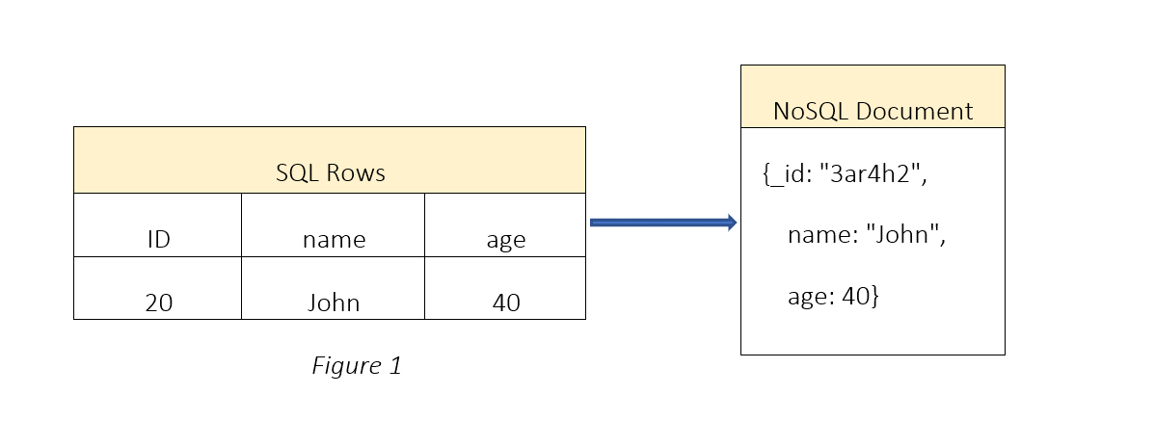
NoSQL Example: Document Store
Instead of using tables with rows and columns, there is a document to store the data
Documents may be closer to the data objects so there may be less modifications needed to retrieve the data
Collections are a group of documents with similar contents, you can also use things like tags or metadata to organize and group the data
Flexible schema is used, the documents don't need to all have the same schema
Document creation is easy, not much maintenance is required
No foreign keys are needed because there is no relationship between documents required
https://blog.usu.com/en-us/schema-design-and-relationship-in-nosql-document-based-databases

Slide 9
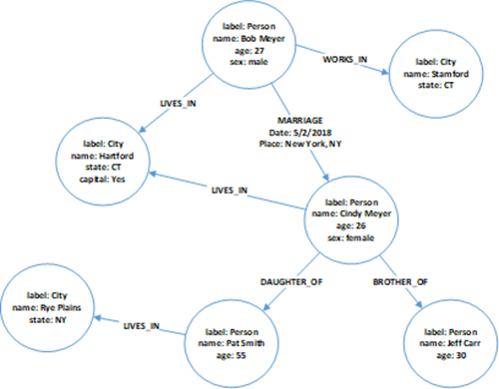
NoSQL Example: Graph Databases
Best for data that has relationships that need a graph to represent them, such as networking topologies or social connections
The focus Is on the relationship been the elements. The nodes on a graph can be connected by links
Query can have real time results for output
How fast results show depend on the number of connections or relationships
Adding data is easy by adding new nodes or edges, schema doesn't need to be changed much
https://bi-insider.com/posts/graph-nosql-database/

